Slide 1


Grass Rendering
Maëlle Colussi, Raphaël David, Lucas Vandroux
Introduction to Computer Graphics
Fall 2012

Slide 2
Demo/Video
on direct...

Slide 3
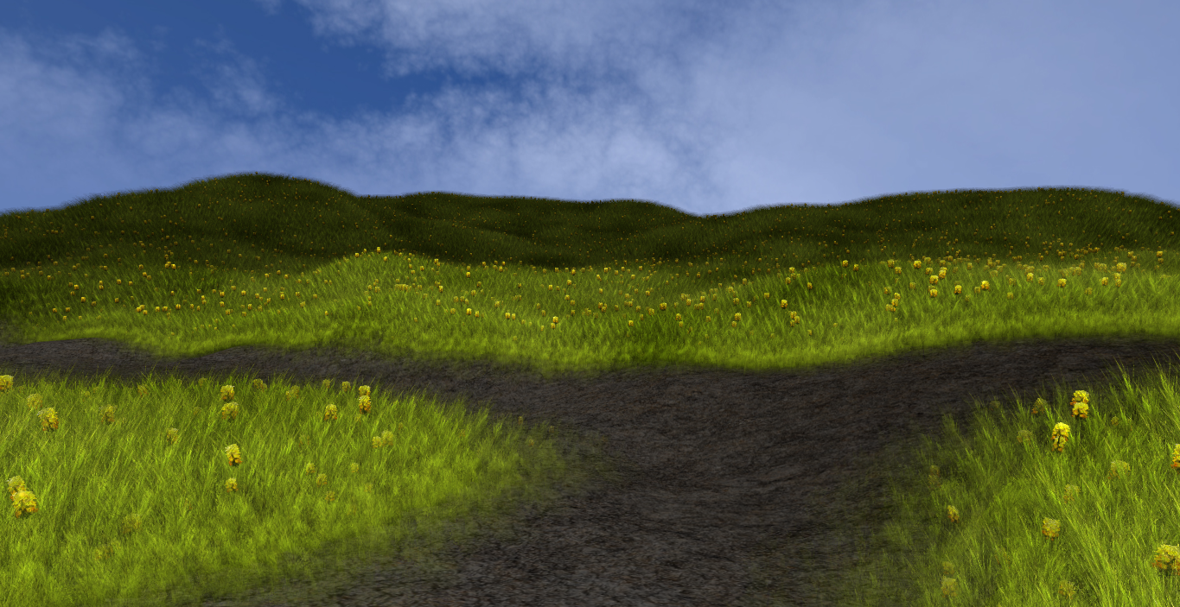
Results

Slide 4
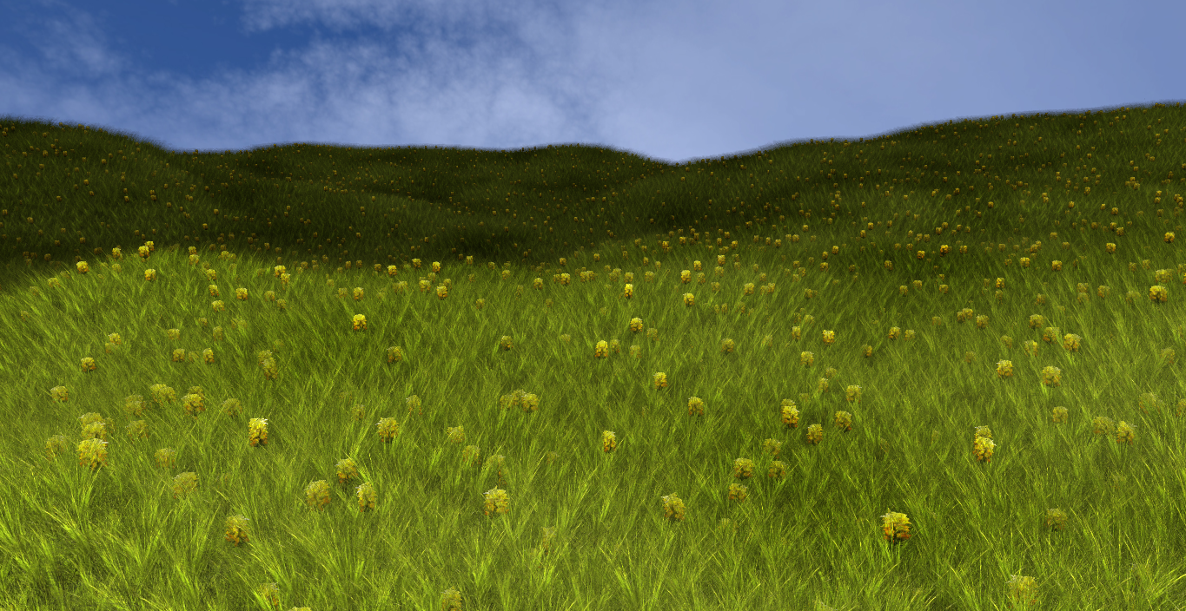
Results (cont.)

Slide 5
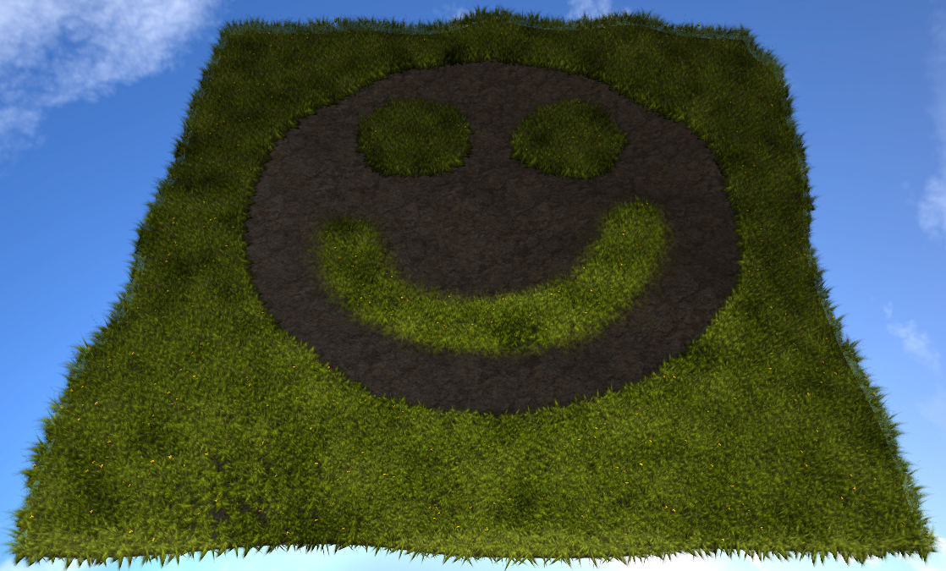
Results (cont.)

Slide 6
Background Information
Explanation of problem
Previous work
Theory

Slide 7
Method
• Need to create a particles system
• For each particle, a blade of grass would be added
• Each blade of grass would consist of two crossed billboard planes with a grass texture

Slide 8
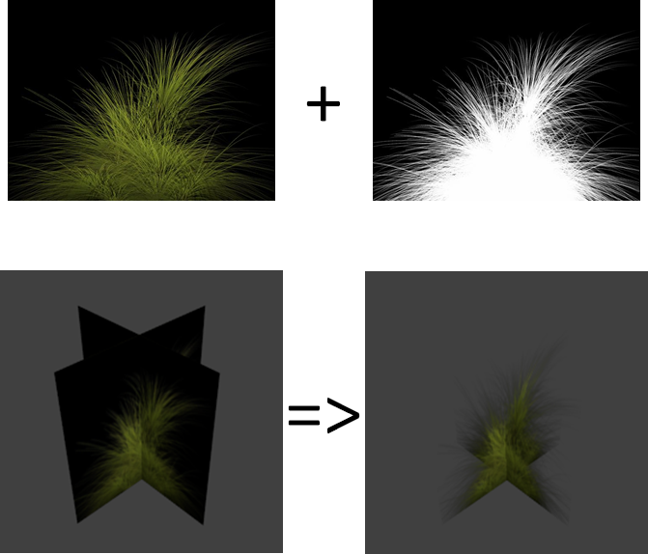
Method: blade of grass

Slide 9
Method: generate the particles
On a terrain plane:
• We use a small pattern of particles (no more than 25)
• This pattern is placed on an extremity of the terrain
• At every step, we draw the particles in an array, translate the pattern and do it again.

Slide 10
Method: generate the particles
On a bumpy terrain:
• We draw the points like if it was on a terrain plane
• x and z coordinates are correct (need to find y)
• We use the uv coordinates of the terrain as a parametrization to find the y value

Slide 11
Method: generate the particles
On a bumpy terrain (algorithm):
• For each point to be drawn, we search the nearest triangle of the terrain
• We transform the x and z coordinates into uv coordinates
• Knowing the barycentric coordinates of the point in 2D, we can find its real position by interpolating the 3d points of the nearest triangle

Slide 12
Problems/Future Work
Problems you encountered
Future work that could be done

